Slide 1


Federal Reserve's Dual Mandate
Intro
Federal Reserve's Dual Mandate: The Federal Reserve, known as the Fed, operates under a dual mandate from Congress to maximize employment and stabilize prices.
Tools of Monetary Policy: The primary tool used by the Fed is the Federal Funds Rate, which influences economic activity.
Purpose of Analysis: This presentation examines whether the Fed has fulfilled its congressional mandate using these economic measures.
Data 608- Story 2
-YINA QIAO

Slide 2
Federal Reserve's Dual Mandate
Data Utilized: Data on CPI, Federal Funds Rate, and Unemployment Rate for the last 25 years were sourced from the BLS and FRED APIs to analyze the Fed's economic impact.
Data 608- Story 2
-YINA QIAO

Slide 3
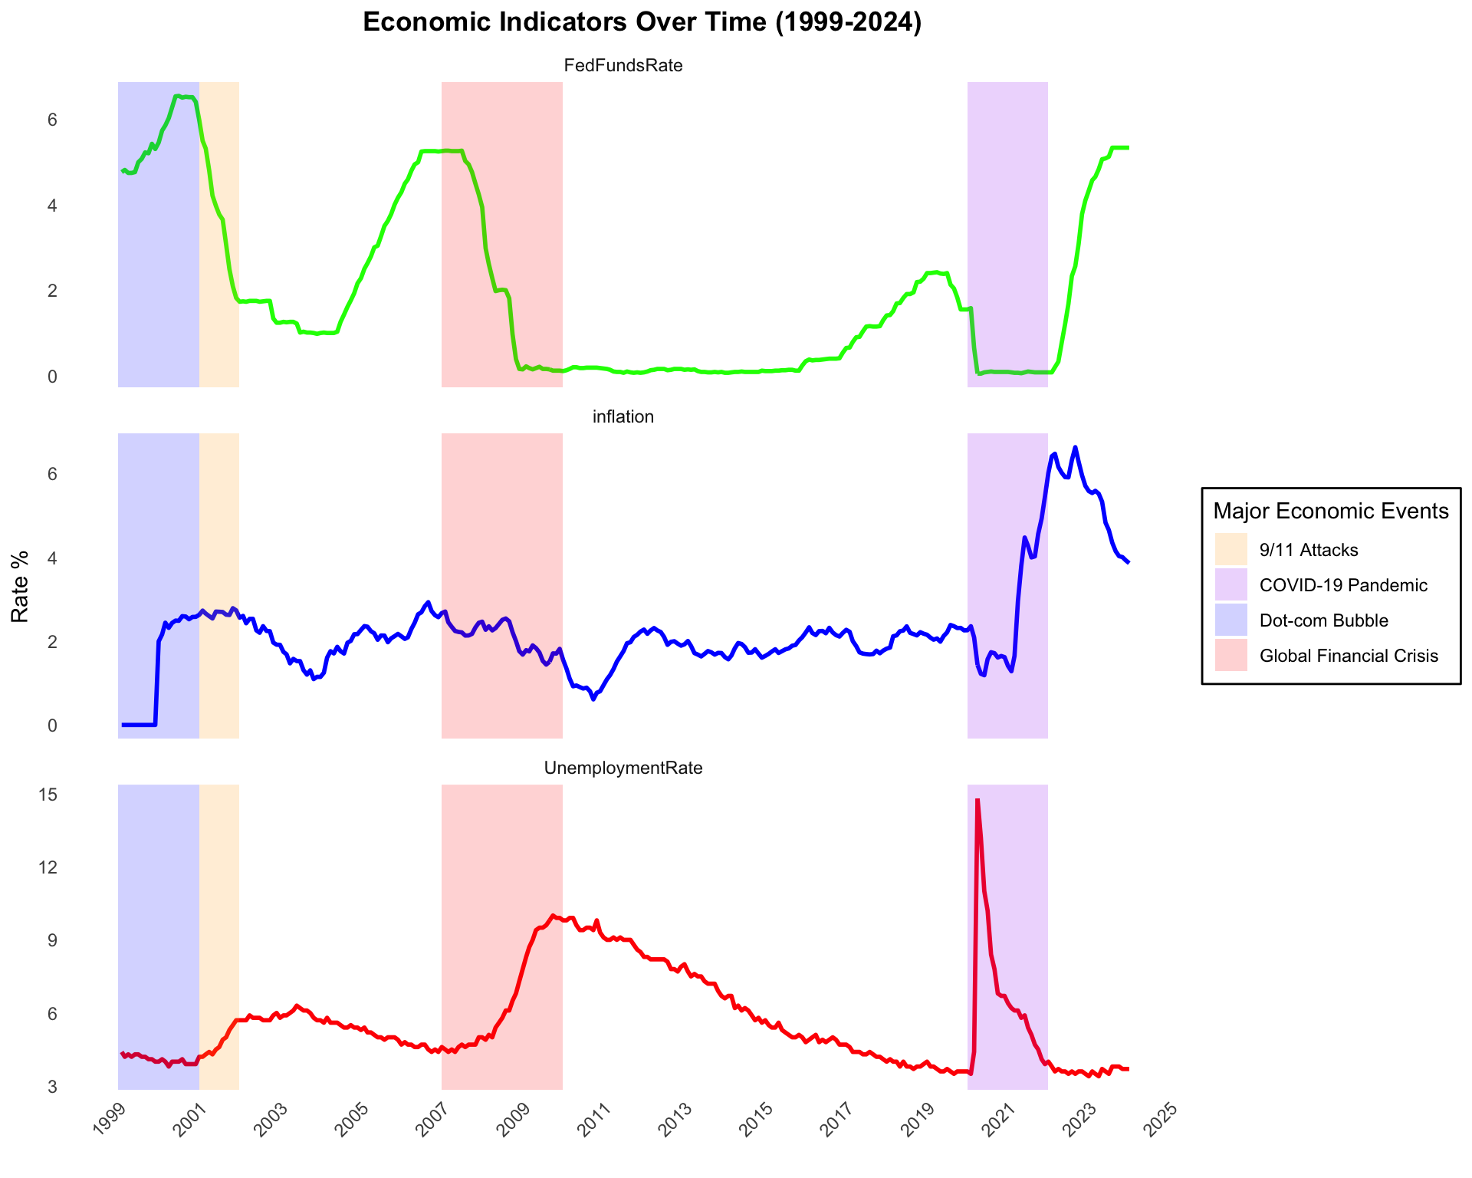
Federal Reserve's Dual Mandate
Historical Context: The economic indicators from 1999 to 2024 highlight the Fed's response to various crises and economic fluctuations.
Data 608- Story 2
-YINA QIAO

Slide 4
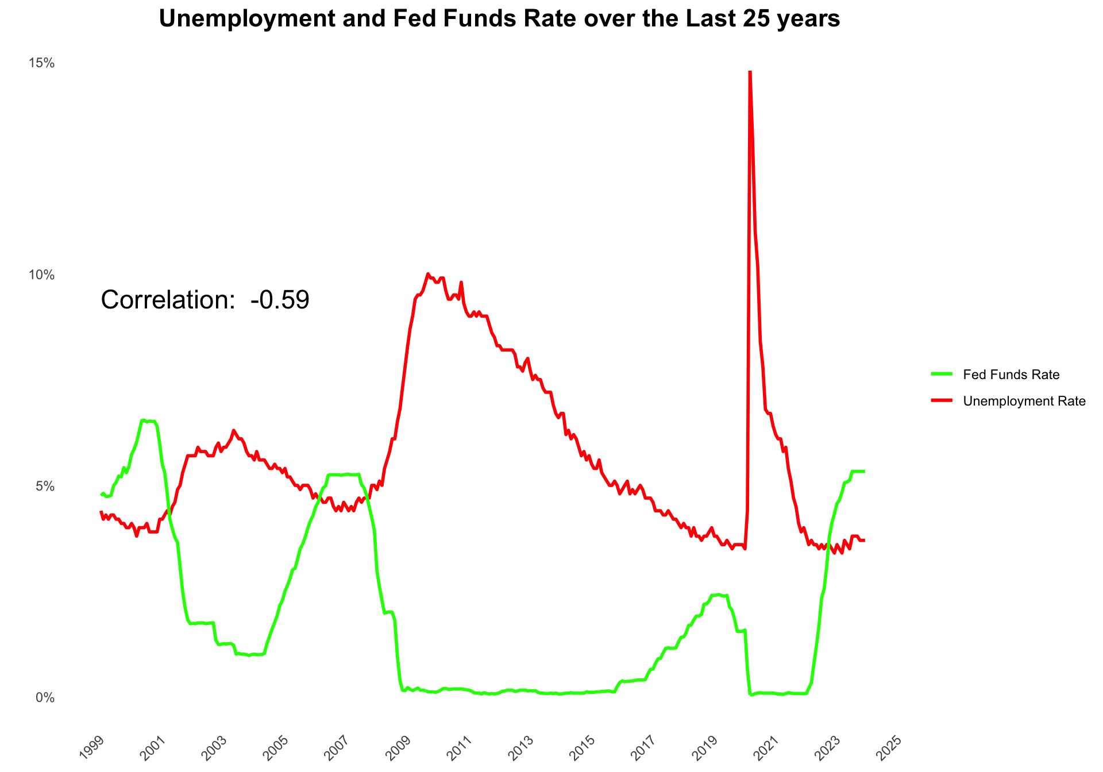
Federal Reserve's Dual Mandate
Negative Correlation:
a negative correlation (-0.59)
between the Fed Funds Rate and Unemployment Rate.
Implications for Monetary Policy:
Increases in the Fed Funds Rate
typically correlate with reductions
in Unemployment Rate, suggesting the Fed's influence on employment.
Data 608- Story 2
-YINA QIAO

Slide 5
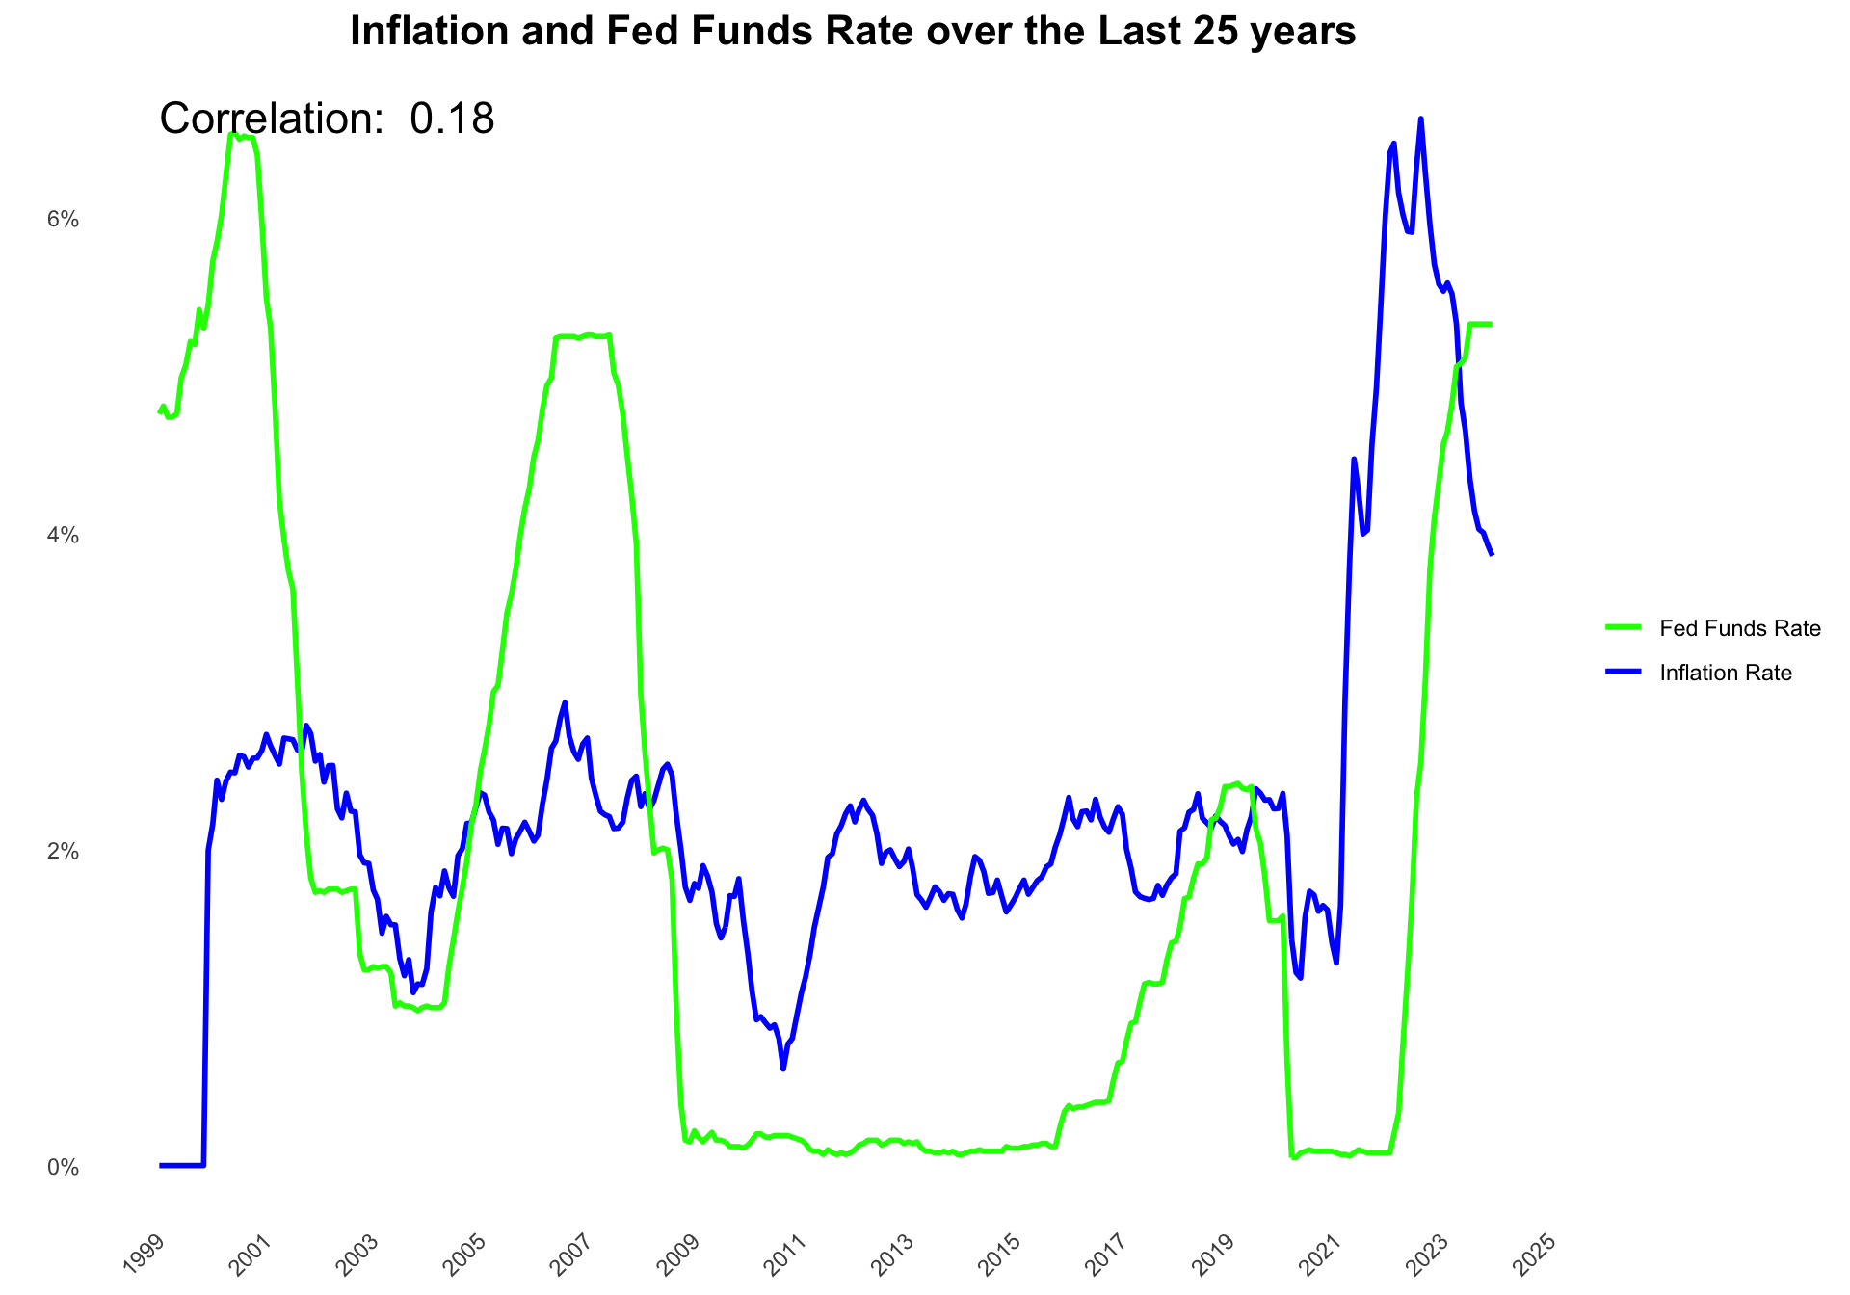
Federal Reserve's Dual Mandate
Positive Correlation: A positive correlation (0.18) between Inflation Rate and Fed Funds Rate over the past 25 years suggests a tendency for these rates to move together.
Fed's Control over Inflation: The correlation indicates that the Fed's adjustments to the Funds Rate have a role in influencing inflation levels.
Data 608- Story 2
-YINA QIAO

Slide 6
Conclusion
Has the FED been able to fulfill the mandate given to it by Congress?
Limitations of the Data: While the trend suggests the Fed's effectiveness in managing unemployment, it does not account for external economic factors that influence the job market.
Consideration of Economic Events: Major events, such as the Dot-com Bubble and the 2008 Financial Crisis, have shown distinct impacts on unemployment, independent of Fed policy.
Influence of External Factors: A variety of external factors, including global economic conditions and supply chain issues, also play a significant role in the dynamics of inflation.
Final Thoughts: Overall, the Fed appears to be moderately effective in fulfilling its congressional mandate.

Slide 7
reference
Source
CPI & Unemployment Data: Bureau of Labor Statistics API - BLS Developer API
Federal Funds Rate Data: Federal Reserve Economic Data API - FRED API

